Slide 1
Introduction To Tracking

Slide 2
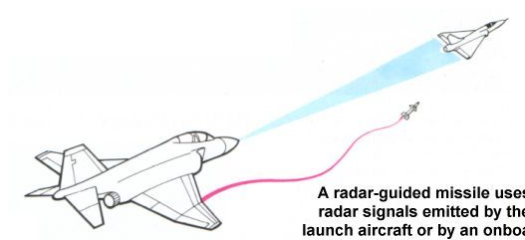
What is Tracking?
Estimating pose (state)
Possible from a variety of measured sensors
Electrical
Mechanical
Inertial
Optical
Acoustic
Magnetic

Slide 3
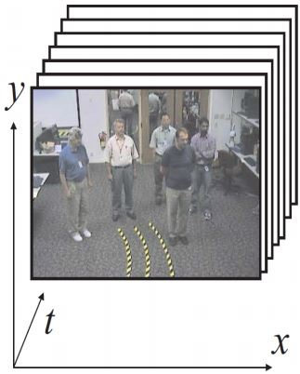
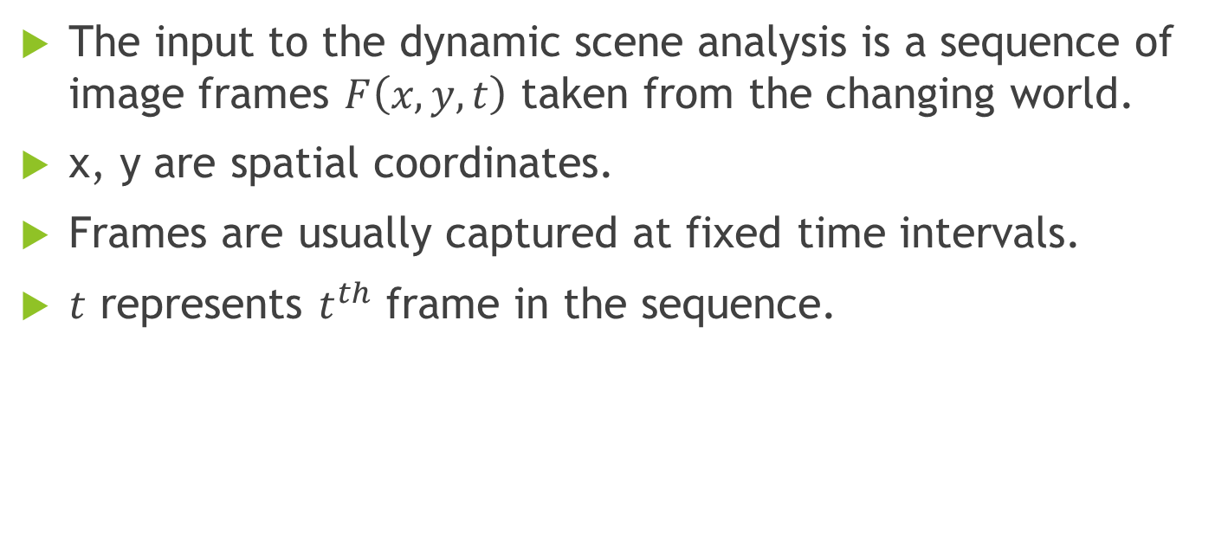
DYNAMIC SCENE ANALYSIS
The input to the dynamic scene analysis is a sequence of image frames $F\left(x,y,t\right)$ taken from the changing world.
x, y are spatial coordinates.
Frames are usually captured at fixed time intervals.
$t$ represents $t^{th}$ frame in the sequence.

Slide 4
Typical Applications
Motion detection. Often from a static camera.
Object localization.
Three-dimensional shape from motion.
Object tracking.
Notes:
1)Common in surveillance systems. Often performed on the pixel level only
(due to speed constraints).
2) Focuses attention to a region of interest in
the image.
3) Called also structure
from motion. Similar problems as in stereo vision.
4) A sparse set of features is often tracked, e.g., corner points.

Slide 5
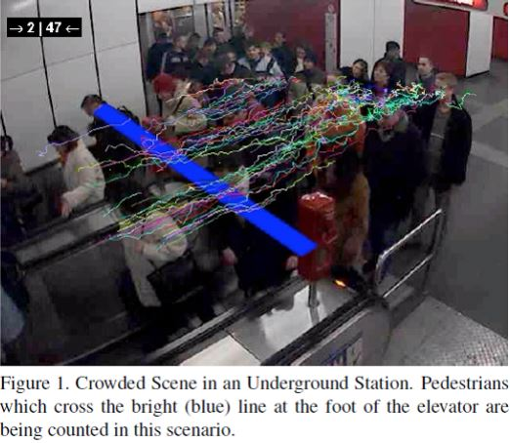
Example Application
Notes:
אפשר להשתמש ב TRACKING למטרות סטטיסטיות כמו ספירת כמה אנשים נכנסים לרכבת ובאיזה שעות, להשתמש במצלמות שכבר פרוסות ברחובות כדי לספור מכוניות בקטע כביש מסויים, מניעת היווצרות פקקים ע"י יעול תזמוני הרמזורים ע"י שילוב מידע של כמה מכוניות באות לצומת מכל צד למשל.. השימושים הם אינסופיים

Slide 6
Object Tracking Definition
Object tracking is the problem of determining
(estimating) the positions and other relevant
information of moving objects in image sequences.

Slide 7
Difficulties In Reliable Object Tracking
Rapid appearance changes caused by
image noise,
illumination changes,
non-rigid motion,
...
Non-stable background
Interaction between multiple objects
...

Slide 8
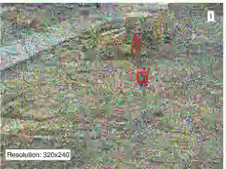
Difficulties In Reliable Object Tracking
Difficult, but not impossible!
Robust Density Comparison for Visual Tracking (BMVC 2009)

Slide 9
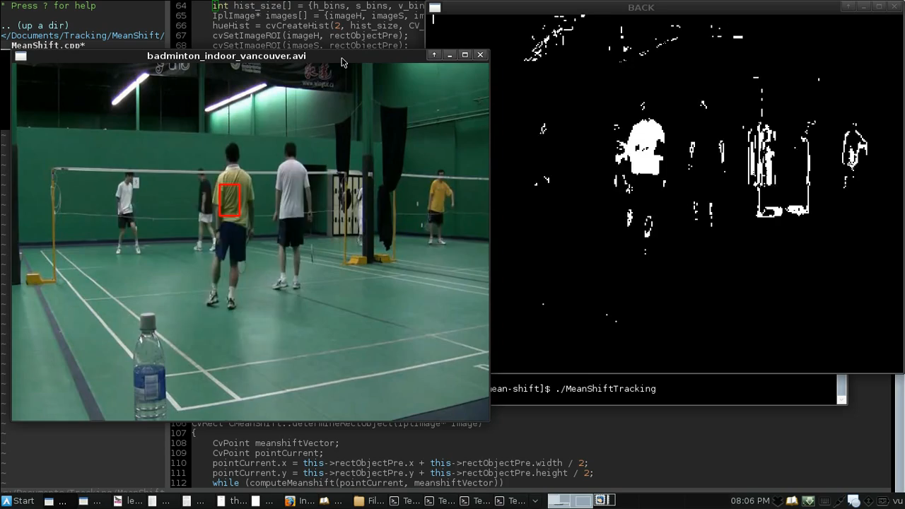
Difficulties In Reliable Object Tracking

Slide 10
Motion Estimation

Slide 11
Block Matching Method
For a given region in one frame, find the corresponding region in the next frame by finding the maximum correlation score (or other block matching criteria) in a search region

Slide 12
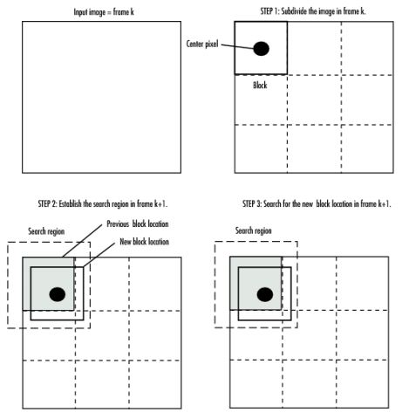
Block Matching Method

Slide 13
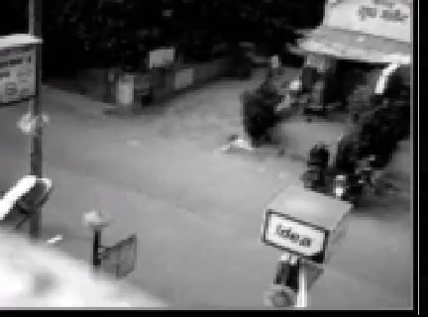
Block Matching Method

Slide 14
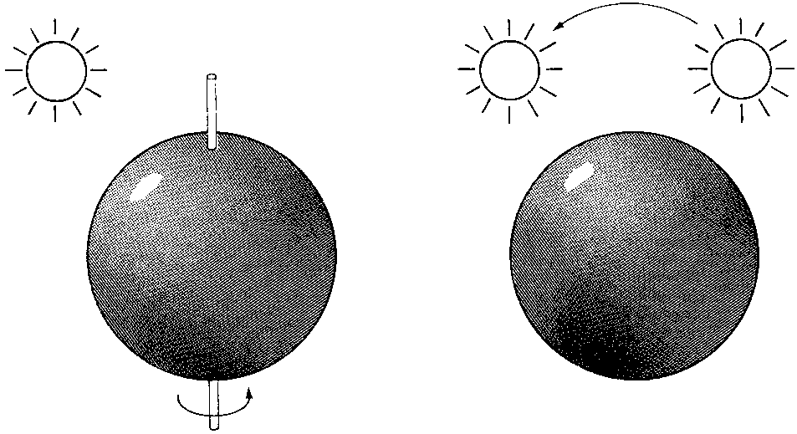
Optical Flow ≠ Motion Field
(a) (b)
Notes:
(a) A smooth sphere is rotating under constant illumination. Thus the optical flow field is zero, but the motion field is not.
(b) A fixed sphere is illuminated by a moving source—the shading of the image changes. Thus the motion field is zero, but the optical flow field is not.

Slide 15
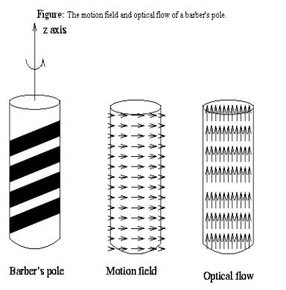

Visible Motion and True Motion
OPTIC FLOW - apparent motion of the same (similar) intensity patterns
Generally, optical flow corresponds to the motion field, but not always:
Notes:
Motion is going right but optic flow is going up

Slide 16
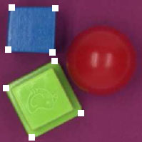
Local Features for Tracking
If strong derivatives are observed in two orthogonal directions then we can hope that this point is more likely to be unique.
Many trackable features are called corners.
Harris Corner Detection !
Notes:
Intuitively, corners—not edges—are the points
that contain enough information to be picked out
from one frame to the next.

Slide 17
Aperture Problem

Slide 18
The Aperture Problem
Different motions – classified as similar
source: Ran Eshel

Slide 19
The Aperture Problem
Similar motions – classified as different
source: Ran Eshel

Slide 20
Tracking Methods

Slide 21
Mean-Shift
The mean-shift algorithm is an efficient approach to tracking objects whose appearance is defined by histograms. (not limited to only color)

Slide 22
Motivation
Motivation – to track non-rigid objects, (like
a walking person), it is hard to specify
an explicit 2D parametric motion model.
Appearances of non-rigid objects can
sometimes be modeled with color
distributions

Slide 23
Mean Shift Theory

Slide 24
Intuitive Description
Region of
interest
Center of
mass
Mean Shift
vector
Objective : Find the densest region
Distribution of identical billiard balls
Stolen from: www.wisdom.weizmann.ac.il/~deniss/vision_spring04/files/mean_shift/mean_shift.ppt

Slide 25
Intuitive Description
Region of
interest
Center of
mass
Mean Shift
vector
Objective : Find the densest region
Distribution of identical billiard balls
Stolen from: www.wisdom.weizmann.ac.il/~deniss/vision_spring04/files/mean_shift/mean_shift.ppt

Slide 26
Intuitive Description
Region of
interest
Center of
mass
Mean Shift
vector
Objective : Find the densest region
Distribution of identical billiard balls
Stolen from: www.wisdom.weizmann.ac.il/~deniss/vision_spring04/files/mean_shift/mean_shift.ppt

Slide 27
Intuitive Description
Region of
interest
Center of
mass
Mean Shift
vector
Objective : Find the densest region
Distribution of identical billiard balls
Stolen from: www.wisdom.weizmann.ac.il/~deniss/vision_spring04/files/mean_shift/mean_shift.ppt

Slide 28
Intuitive Description
Region of
interest
Center of
mass
Mean Shift
vector
Objective : Find the densest region
Distribution of identical billiard balls
Stolen from: www.wisdom.weizmann.ac.il/~deniss/vision_spring04/files/mean_shift/mean_shift.ppt

Slide 29
Intuitive Description
Region of
interest
Center of
mass
Mean Shift
vector
Objective : Find the densest region
Distribution of identical billiard balls

Slide 30
Intuitive Description
Region of
interest
Center of
mass
Objective : Find the densest region
Distribution of identical billiard balls
Stolen from: www.wisdom.weizmann.ac.il/~deniss/vision_spring04/files/mean_shift/mean_shift.ppt

Slide 31
Mean Shift Vector
Given:
Data points and approximate location of the mean of this data:
Task:
Estimate the exact location of the mean of the data by determining the shift vector from the initial mean.
Notes:
We keep doing this iteratively until we do not have to move any more. Until the shift vector is zero.

Slide 32
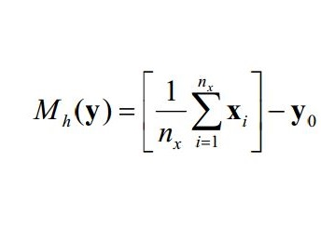
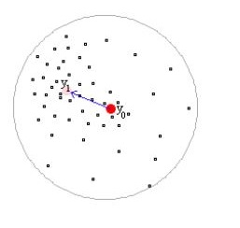
Mean Shift Vector
Notes:
Nx = the number of points
We find the mean by adding up all the points, which are represented by a two dimensional vector (x,y) and dividing by the total number of points.
Then we substract the point where we started, so we get a vector.
The mean shift vector always points to the direction of the densest point of data points

Slide 33
A Quick PDF Definition
A probability density function (pdf), is a function that describes the relative likelihood for this random variable to take on a given value.
Notes:
פונקציית צפיפות של משתנה מקרי היא פונקציה המתארת את צפיפות המשתנה בכל נקודה במרחב המדגם.
ההסתברות שמשתנה מקרי יימצא בקטע מסוים היא האינטגרל של הצפיפות בקטע ולכן המשתנה נוטה יותר לקבל ערכים שבהם הצפיפות גבוהה.

Slide 34
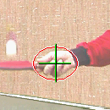
Mean-Shift Object Tracking Target Representation
Choose a reference target model
Choose a feature space
Represent the model by its PDF in the feature space
Quantized Color Space
Stolen from: www.cs.wustl.edu/~pless/559/lectures/lecture22_tracking.ppt

Slide 35
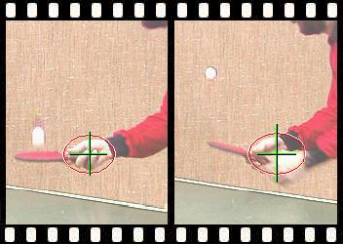
Mean-Shift Object Tracking PDF Representation
Target Model
(centered at 0)
Target Candidate
(centered at y)
Similarity Function:
Q is the target histogram,
P is the object histogram (depends on location y)
Stolen from: www.cs.wustl.edu/~pless/559/lectures/lecture22_tracking.ppt

Slide 36
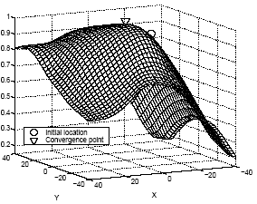
Mean-Shift Object Tracking Target Localization Algorithm
Start from the position of the model in the current frame
Search in the model’s neighborhood in next frame
Find best candidate by maximizing a similarity func.
Stolen from: www.cs.wustl.edu/~pless/559/lectures/lecture22_tracking.ppt

Slide 37
Mean Shift
Mean-Shift in tracking task:
track the motion of a cluster of interesting
features.
1. choose the feature distribution to represent
an object (e.g., color + texture),
2. start the mean-shift window over the feature
distribution generated by the object
3. finally compute the chosen feature
distribution over the next video frame.

Slide 38
Mean Shift
Starting from the current window location, the
mean-shift algorithm will find the new peak or
mode of the feature distribution, which
(presumably) is centered over the object that
produced the color and texture in the first
place.
In this way, the mean-shift window tracks
the movement of the object frame by frame.

Slide 39
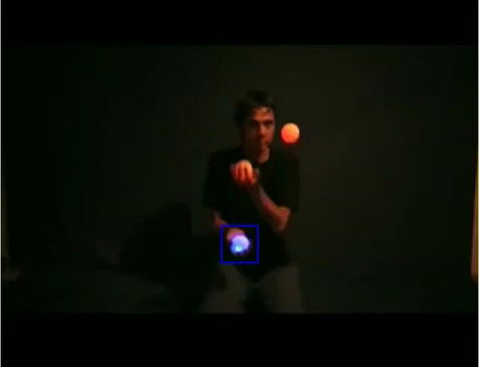
Examples

Slide 40
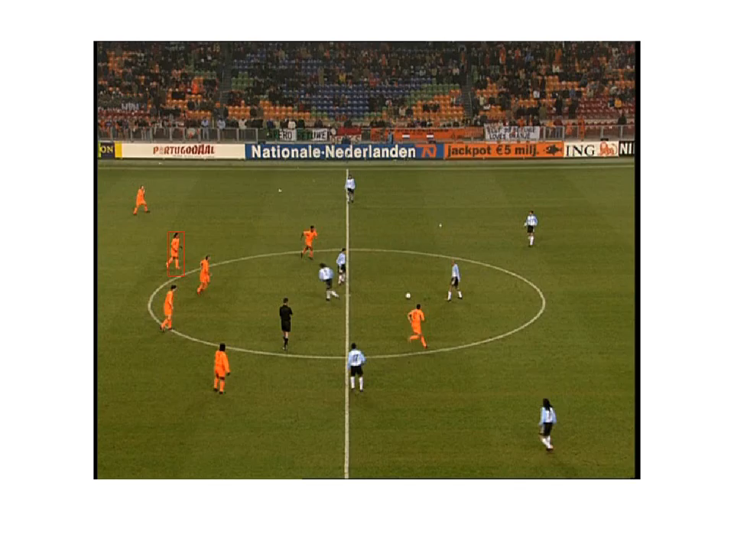
Examples

Slide 41
Other Mean Shift Applications

Slide 42
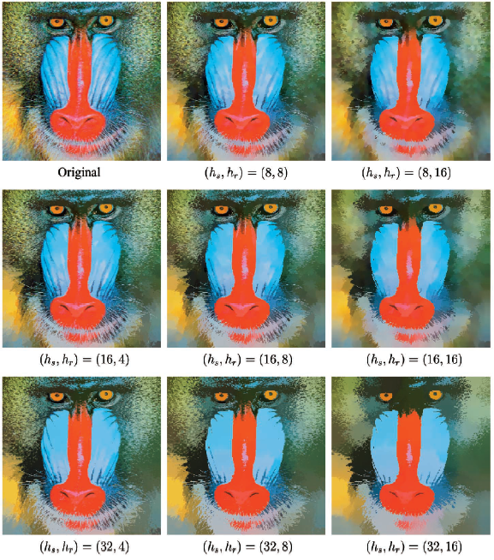
Edge Preserving Smoothing

Slide 43
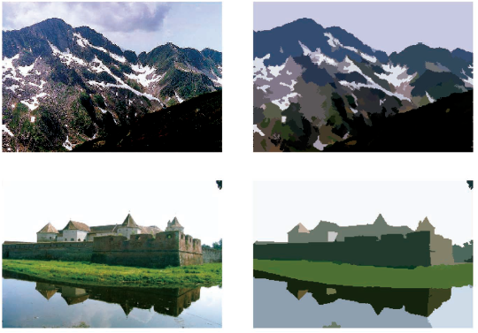
Segmentation

Slide 44
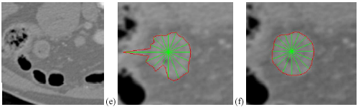
Contour Detection

